Slide 1
Bootstrap
ST2220 WEB APPLICATION DEVELOPMENT

Slide 2

What is Bootstrap?
Bootstrap was developed by Mark Otto and Jacob Thornton at Twitter as a framework to encourage consistency across internal tools.
Before Bootstrap, various libraries were used for interface development, which led to inconsistencies and a high maintenance burden.
Bootstrap is a free collection of tools for creating websites and web applications
Bootstrap contains HTML and CSS-based design templates for text, forms, buttons, navigation and other components
Bootstrap also contains optional JavaScript extensions

Slide 3
Why Bootstrap?
Makes front-end web development faster and easier.
Easily and efficiently scales your websites and applications with a single code base, from phones to tablets to desktops with CSS media queries.

Slide 4
What You Should Already Know?
Before you continue you should have a basic understanding of the following:
HTML (link: http://www.w3schools.com/html/default.asp)
CSS (link: http://www.w3schools.com/css/default.asp)
JavaScript (link: http://www.w3schools.com/js/default.asp)
jQuery (link: http://www.w3schools.com/jquery/default.asp)

Slide 5
Getting Started
Include the HTML5 doctype at the beginning of the page, along with the correct character set:
<!DOCTYPE html>
<html>
<head>
<meta charset="utf-8">
</head>
</html>
Notes:
Each code line in PHP must end with a semicolon.
The semicolon is a separator and is used to distinguish one set of instructions from another.
Two basic statements to output text in the browser: echo and print.

Slide 6
Getting Started
add the viewport meta tag inside the <head> element: width=device-width sets the width of the page to follow the screen-width of the device. The initial-scale=1 sets the initial zoom level when the page is first loaded by the browser.
<meta name="viewport" content="width=device-width, initial-scale=1">
Notes:
Each code line in PHP must end with a semicolon.
The semicolon is a separator and is used to distinguish one set of instructions from another.
Two basic statements to output text in the browser: echo and print.

Slide 7
Adding Bootstrap to Your Web Pages
There are two ways of starting to use Bootstrap on your own web site.
Download Bootstrap from getbootstrap.com
Include Bootstrap from a CDN, like MaxCDN
<!-- Latest compiled and minified CSS -->
<link rel="stylesheet" href="http://maxcdn.bootstrapcdn.com/bootstrap/3.2.0/css/bootstrap.min.css">
<!-- Optional: Include the jQuery library -->
<script src="https://ajax.googleapis.com/ajax/libs/jquery/1.11.1/jquery.min.js"></script>
<!-- Optional: Incorporate the Bootstrap JavaScript plugins -->
<script src="http://maxcdn.bootstrapcdn.com/bootstrap/3.2.0/js/bootstrap.min.js"></script>
Notes:
Each code line in PHP must end with a semicolon.
The semicolon is a separator and is used to distinguish one set of instructions from another.
Two basic statements to output text in the browser: echo and print.

Slide 8
Adding Bootstrap to Your Web Pages
Bootstrap also requires a containing element to wrap site contents.
There are two containers to choose from:
1. Use the .container class for a responsive fixed width container:
2. Use the .container-fluid class for a full width container, spanning the entire width of the viewport:
<div class="container">
...
</div>
<div class="container-fluid">
...
</div>
Notes:
Each code line in PHP must end with a semicolon.
The semicolon is a separator and is used to distinguish one set of instructions from another.
Two basic statements to output text in the browser: echo and print.

Slide 9
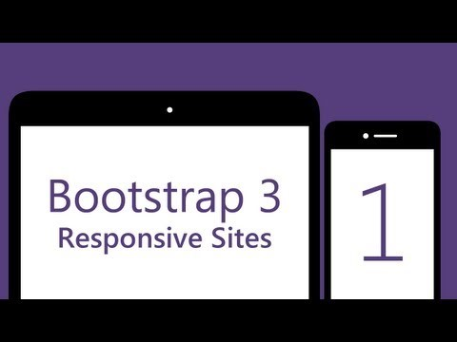
# 1 - Build a responsive Bootstrap 3 site by Coder's Guide

Slide 10

#2 - Responsive Collapsing Navbar by Coder's Guide

Slide 11
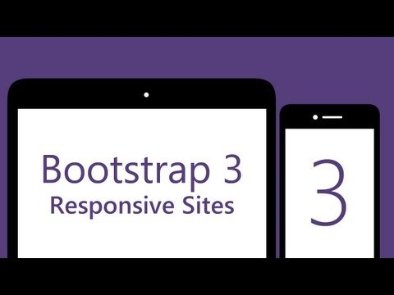
#3 - Sticky Footer That Stays In The Browser Viewport by Coder's Guide

Slide 12

# 3 - Addon by Coder's Guide

Slide 13
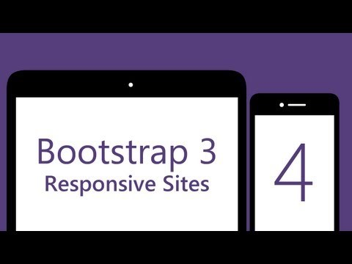
#4 - Jumbotrons by Coder's Guide

Slide 14

#5 - Responsive Grid System by Coder's Guide
More on Grid System http://www.w3schools.com/bootstrap/bootstrap_grid_system.asp

Slide 15
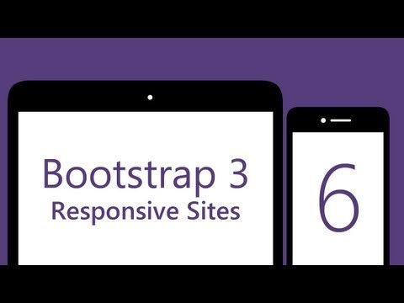
#6 - Modals (Popup Boxes) by Coder's Guide
More on Form http://www.w3schools.com/bootstrap/bootstrap_forms.asp

Slide 16
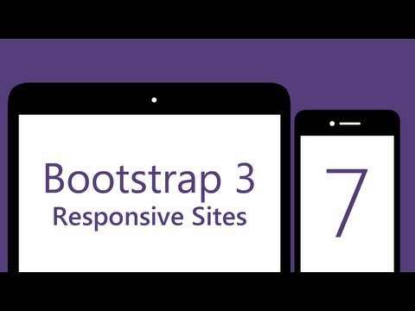
#7 - Beginning the article page by Coder's Guide

Slide 17

#8 - Article Sidebar by Coder's Guide

Slide 18

# 9 - Contact Form (in modal) by Coder's Guide

Slide 19
End

